Slide 1
Let’s Learn About Modes!
Daniel Lee
justdaniel2009@gmail.com

Slide 2
Review
What are the two most common forms of scales we know?

Slide 3
Review
What are the two most common forms of scales we know?
  Major
  Minor

Slide 4
Review
What are the two most common forms of scales we know?
  Major
  Minor
For today, the words “key” and “scale” may be used interchangeably.

Slide 5
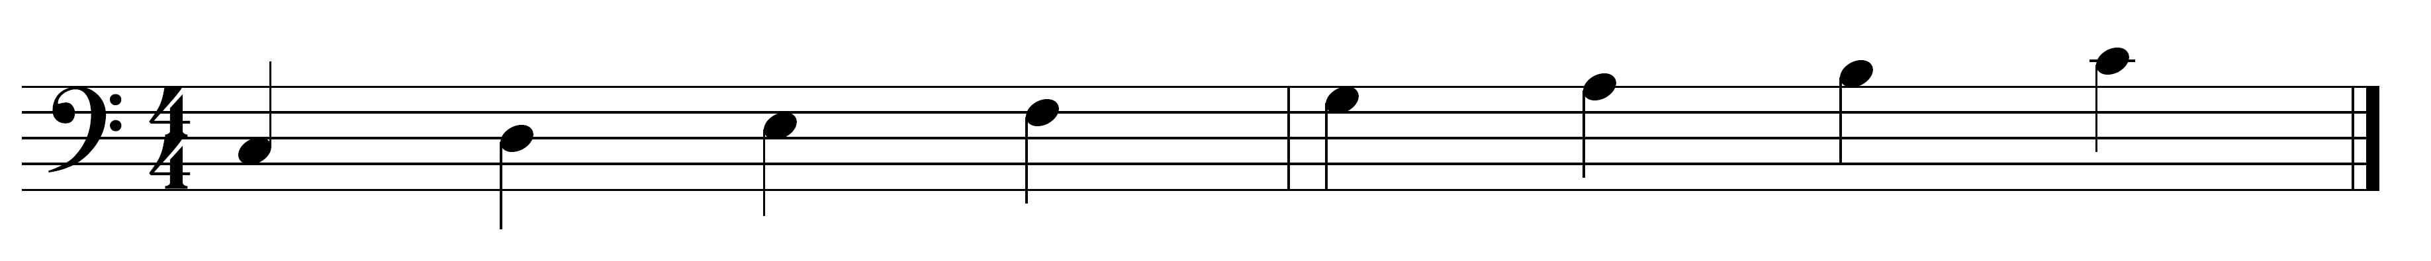
Review
What type of scale is this?

Slide 6
Review
What type of scale is this?
Major! (C Major)

Slide 7
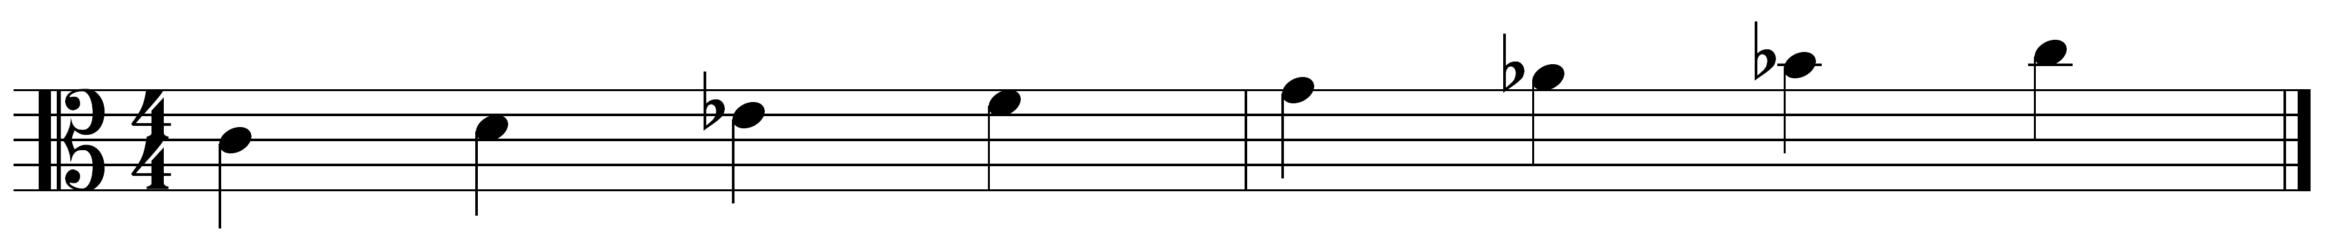
Review
What type of scale is this?
(Alto Clef: remember that middle line is Middle C)

Slide 8
Review
What type of scale is this?
(Alto Clef: remember that middle line is Middle C)
Minor! (C minor)

Slide 9
Major and Minor scales belong to a bigger group of
scales/keys called Modes.

Slide 10
Modes
Follow along on the worksheet
3 new modes
  They all relate to the major or minor scale

Slide 11

Example 1
Here’s how it sounds:

Slide 12
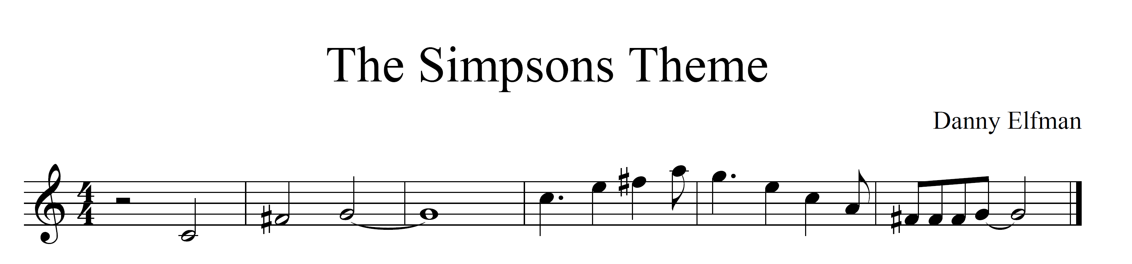
Example 1
Here’s how it looks:

Slide 13
Example 1
Here’s how it looks:
On the worksheet, answer the three questions for Example 1

Slide 14
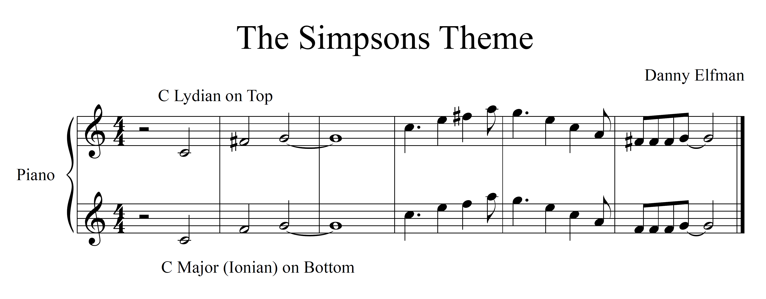
Example 1
How it would sound without the F# (bottom line):

Slide 15
Example 2
Here’s how it sounds:
Here’s how it sounds with just the melody:

Slide 16
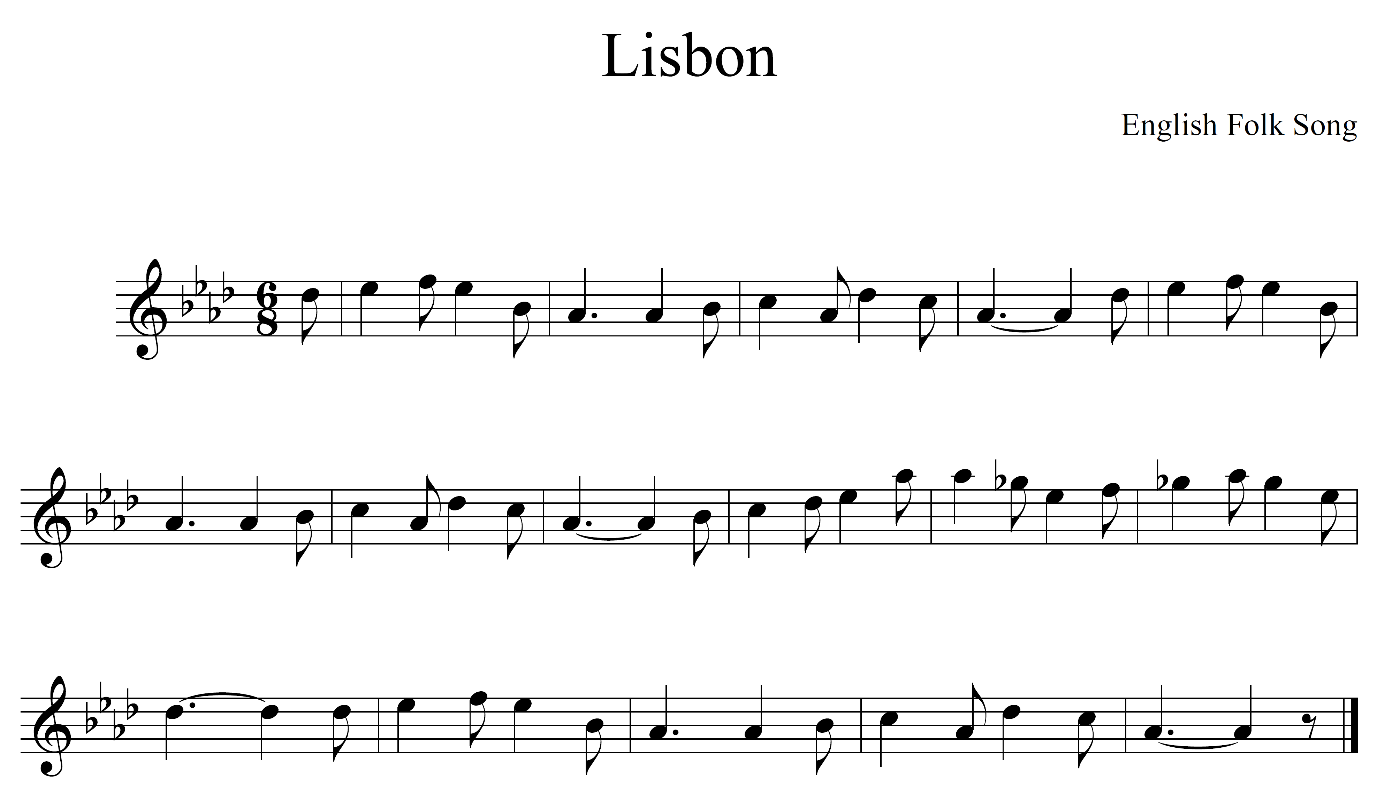
Example 2
Here’s how it looks:
On the worksheet, answer the three questions for Example 2

Slide 17
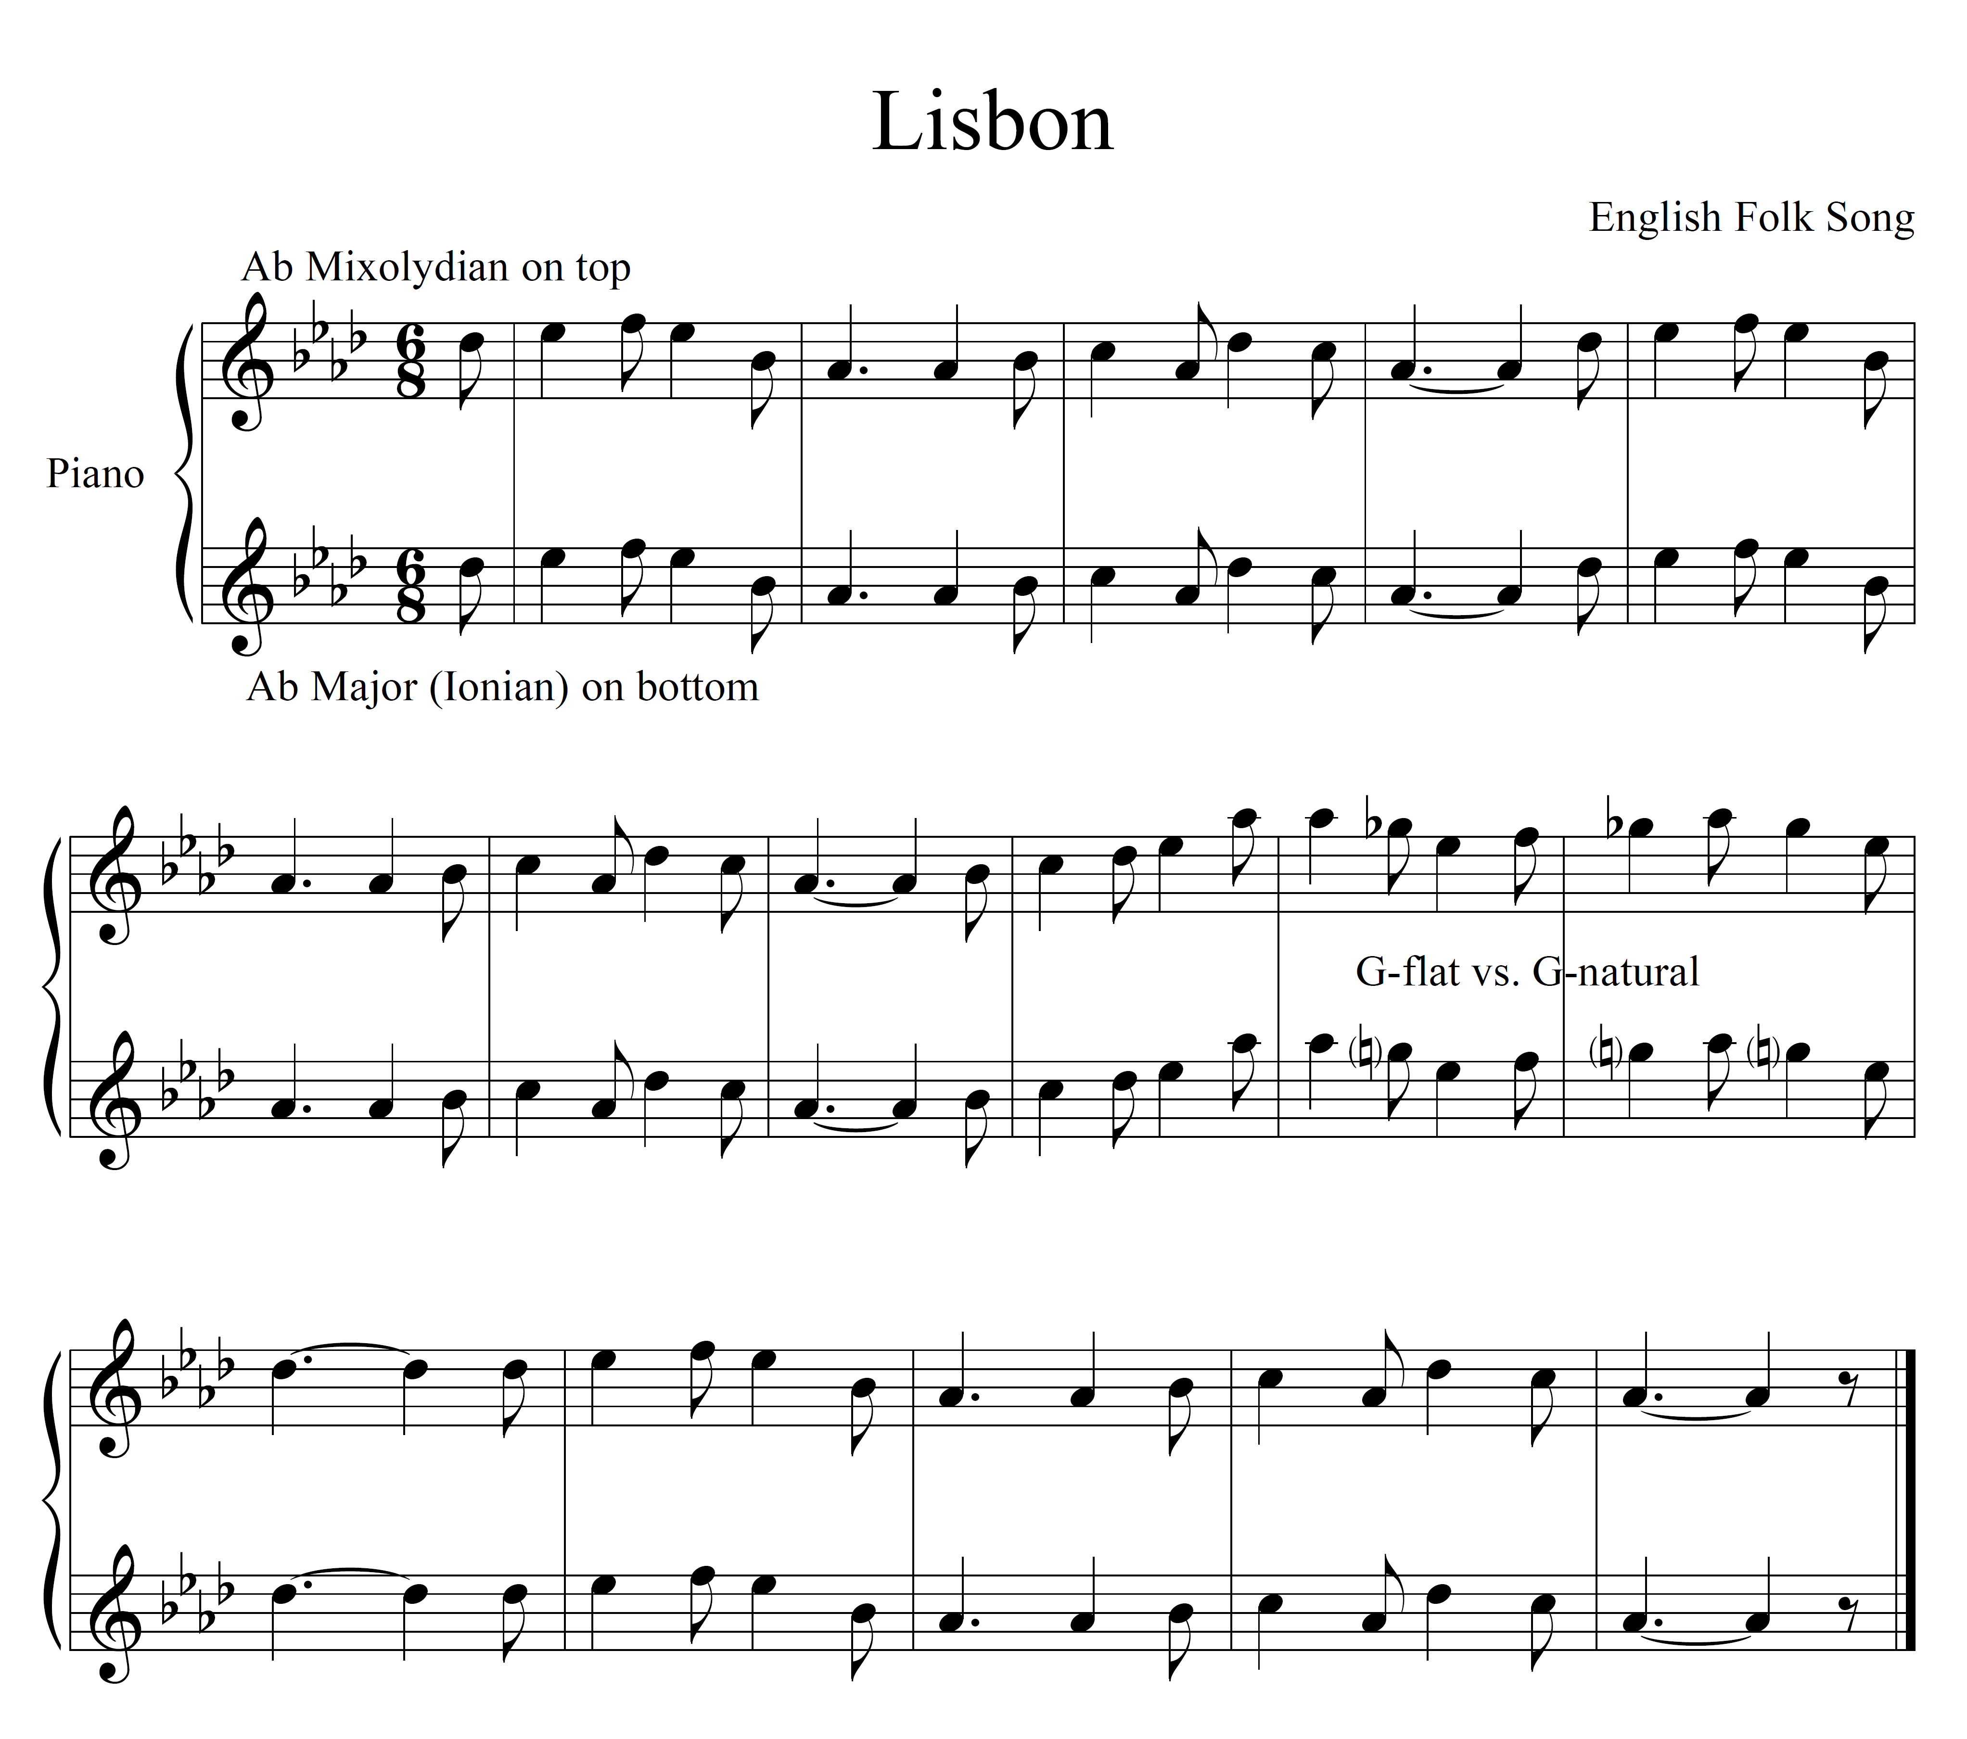
Example 2
Top line review (Ab Mixolydian, original):

Slide 18
Example 2
Bottom line (Ab Major, if the melody matched the key signature):

Slide 19
Example 3
Here’s how it sounds:

Slide 20
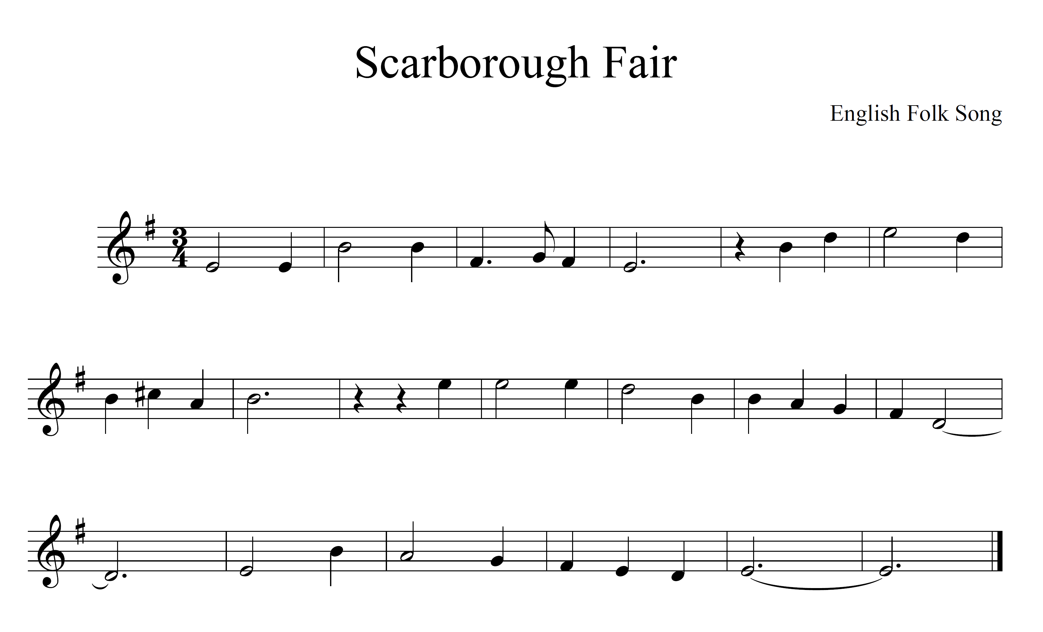
Example 3
Here’s how it looks:
On the worksheet, answer the three questions for Example 3

Slide 21
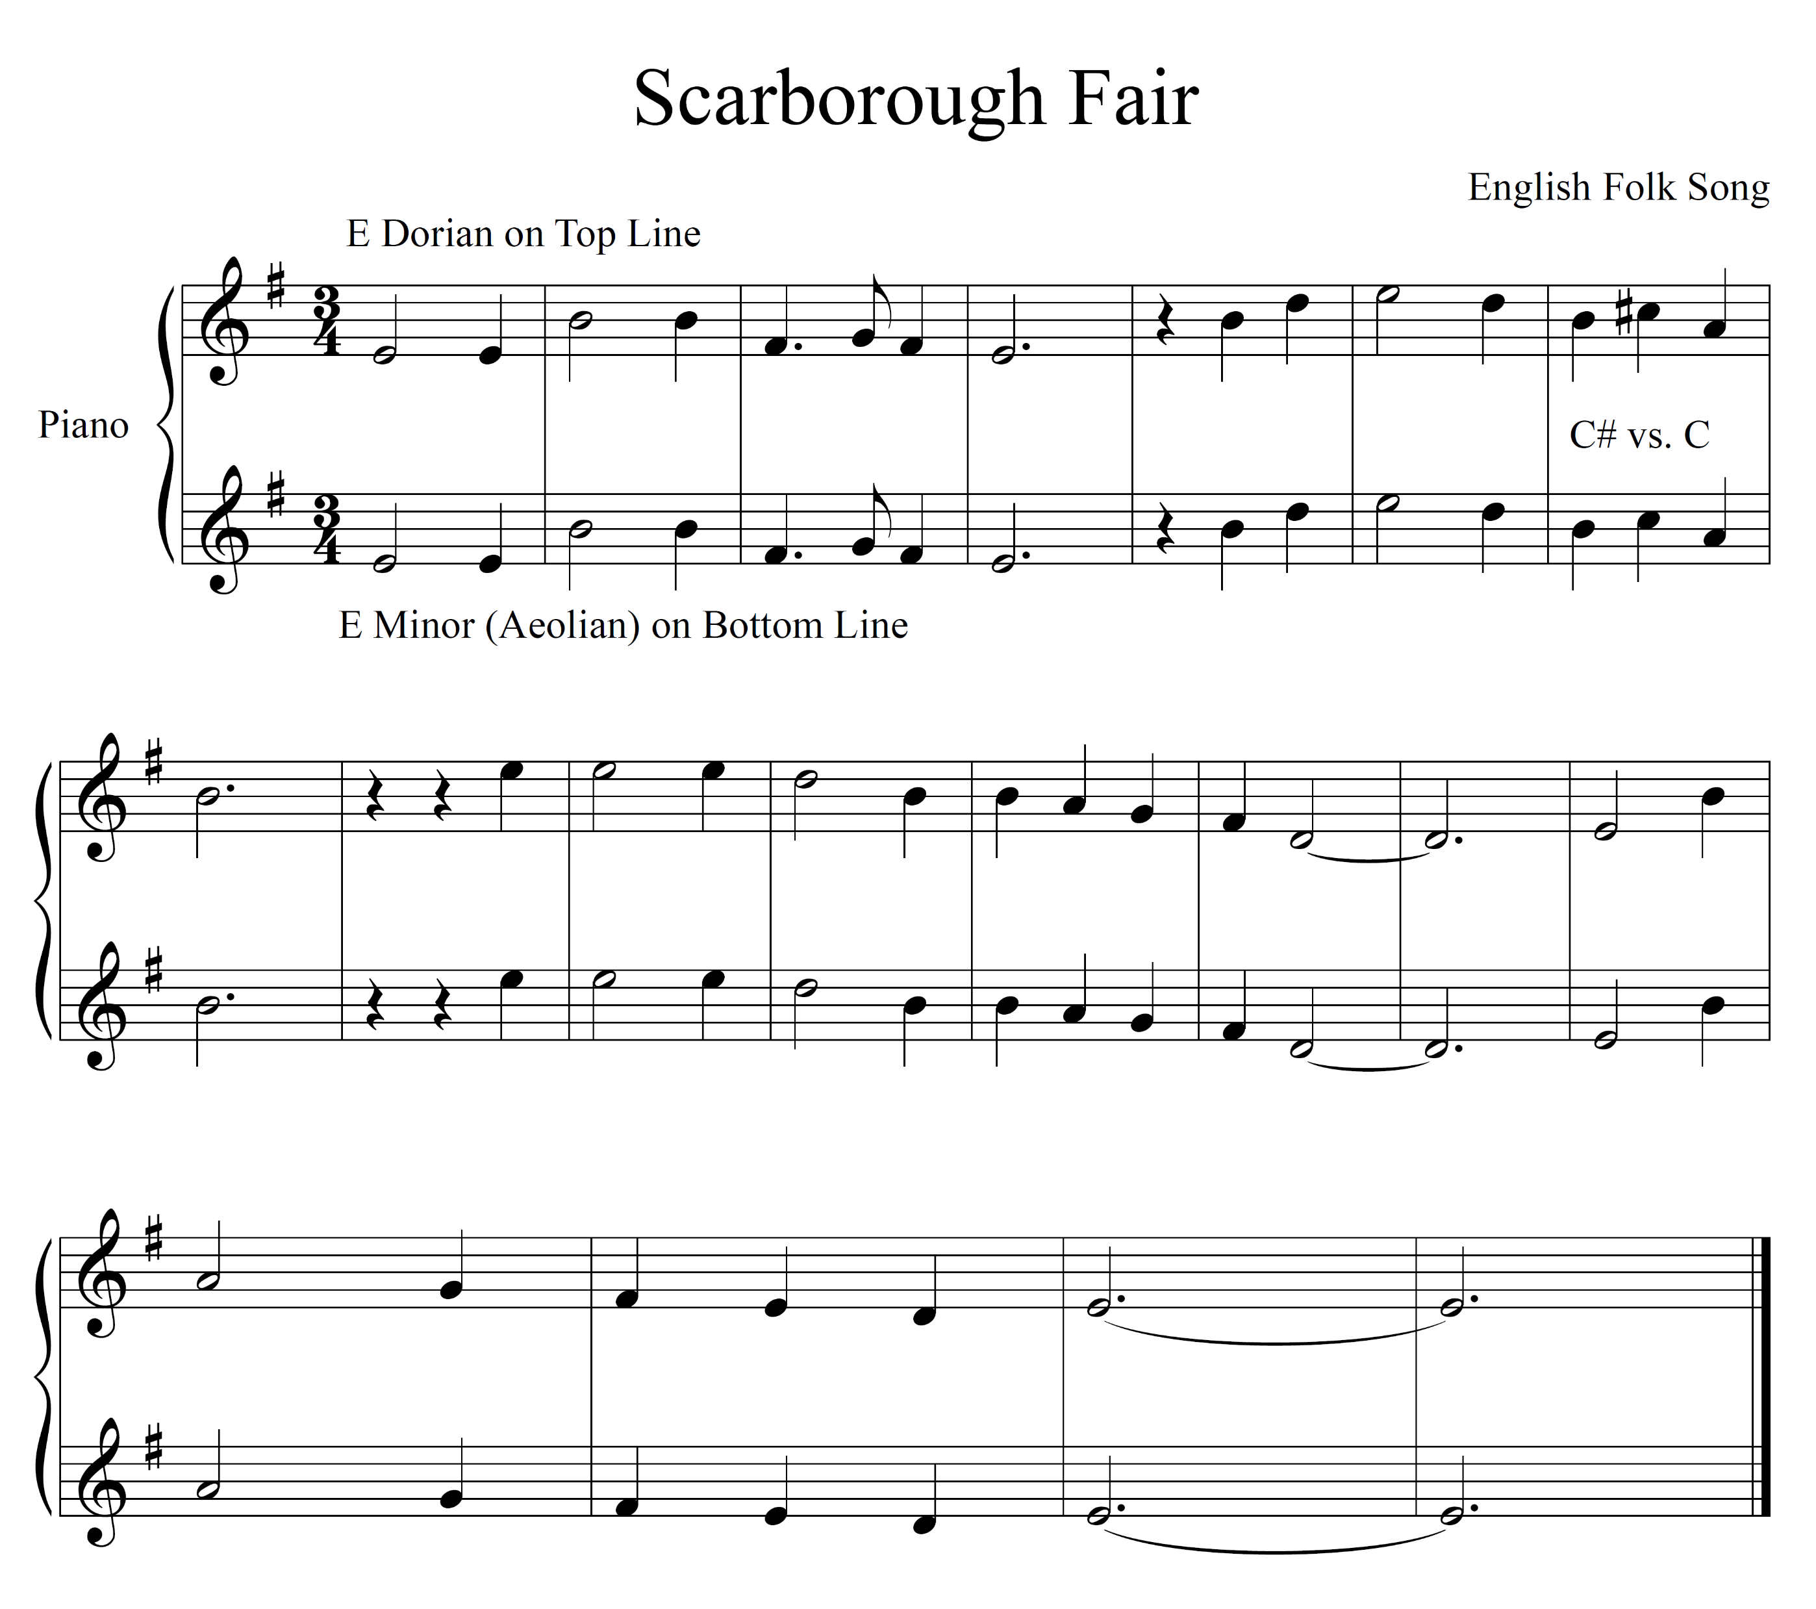
Example 3
Here’s how it sounds without
Th C# (bottom line):

Slide 22
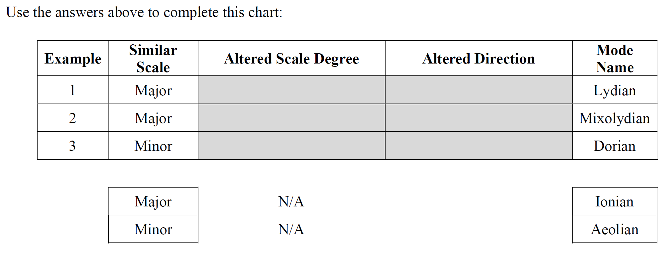
Worksheet
Fill out the chart at the end of the worksheet. Use your previous answers to fill in the gray boxes.

Slide 23
Worksheet
Another name for the major scale is the Ionian scale.
Another name for the minor scale is the Aeolian scale.
How could we describe the Lydian, Mixolydian, and Dorian scales in relation to the major or minor scale?

Slide 24
Let’s Sing!
Watch my demo
Take a few minutes to experiment with the tools on your own
Sing together
https://learningmusic.ableton.com/advanced-topics/modes.html

Slide 25
About Modes
Originate from Ancient Greek musical systems, Greek Modes
  Medieval Church used a similar system, sometimes called Church Modes

Slide 26
About Modes
Originate from Ancient Greek musical systems, Greek Modes
  Medieval Church used a similar system, sometimes called Church Modes
Why do they exist?
  They exist in many folk melodies throughout the world
  Major/minor tonalities are not a worldwide standard
  Composers use them for certain effects because qualities change between modes (especially Leading Tone (LT) placement)

Slide 27
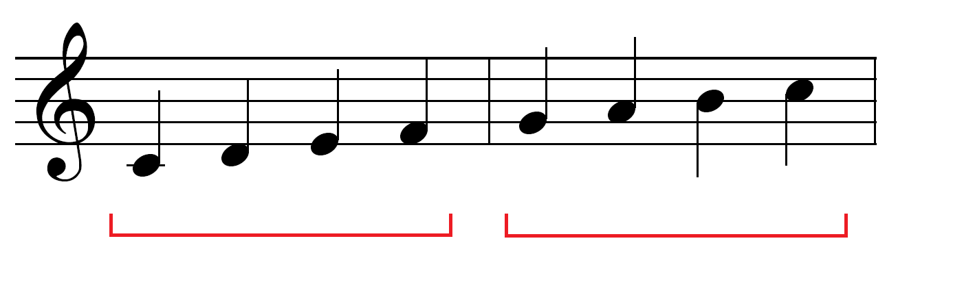
About Modes
Ionian Mode (Major)
Two tetrachords that sound major, have LT at end.

Slide 28
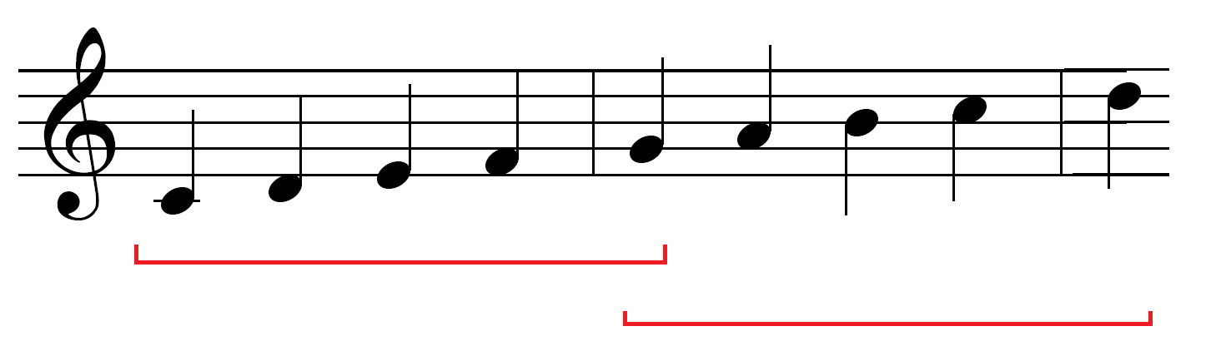
About Modes
Ionian Mode (Major)
Two pentachords, strong Tonic/Dominant combination.

Slide 29
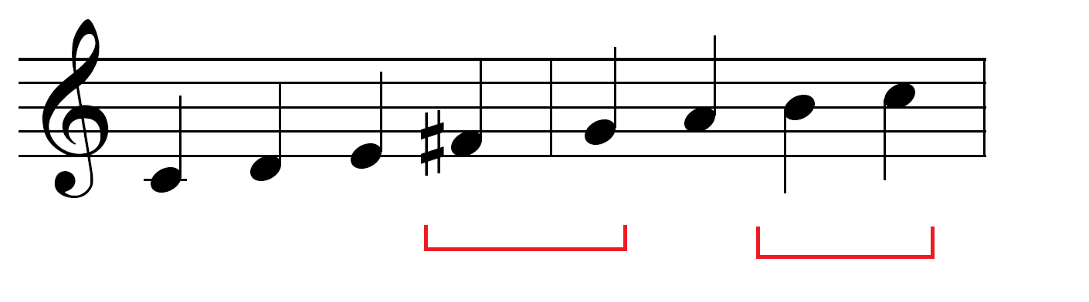
About Modes
Lydian Mode
Leading tones for both Tonic and Dominant.

Slide 30
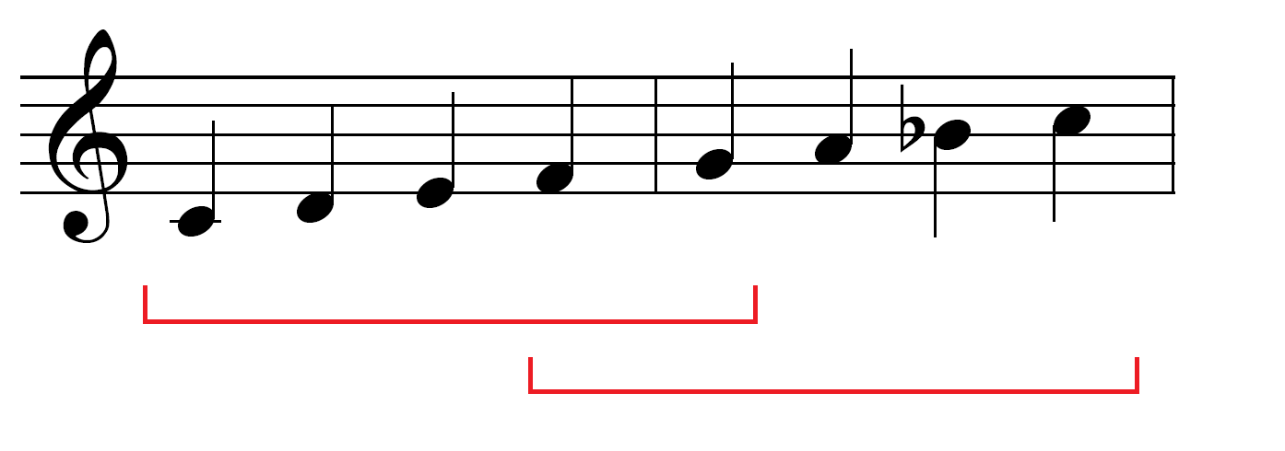
About Modes
Mixolydian Mode
Two major pentachords, like Major/Ionian, but in different places.
(Refer back to Example 2)

Slide 31
About Modes
Are there other modes?
  Yes, we haven’t learned the Phrygian or Locrian modes yet.
  Phrygian appears less frequently in Western music, and Locrian is more a theoretical mode.

Slide 32
About Modes
Are there other modes?
  Yes, we haven’t learned the Phrygian or Locrian modes yet.
  Phrygian appears less frequently in Western music, and Locrian is more a theoretical mode.
Are there other scale types?
  Definitely: Pentatonic, Octatonic, Chromatic, scales used frequently in Jazz, ragas (Indian), scales not based on Western chromaticism (1/4 tones, etc.).

Slide 33
Self-Check
Tonic/Implied Key Mode Altered Note
C Major Lydian F# (raised 4th)

Slide 34
Self-Check
Tonic/Implied Key Mode Altered Note
C Major Lydian F# (raised 4th)
F Major Lydian

Slide 35
Self-Check
Tonic/Implied Key Mode Altered Note
C Major Lydian F# (raised 4th)
F Major Lydian B natural (raised 4th)

Slide 36
Self-Check
Tonic/Implied Key Mode Altered Note
C Major Lydian F# (raised 4th)
F Major Lydian B natural (raised 4th)
G Major Mixolydian

Slide 37
Self-Check
Tonic/Implied Key Mode Altered Note
C Major Lydian F# (raised 4th)
F Major Lydian B natural (raised 4th)
G Major Mixolydian F natural (lowered 7th)

Slide 38
Self-Check
Tonic/Implied Key Mode Altered Note
C Major Lydian F# (raised 4th)
F Major Lydian B natural (raised 4th)
G Major Mixolydian F natural (lowered 7th)
D minor Dorian

Slide 39
Self-Check
Tonic/Implied Key Mode Altered Note
C Major Lydian F# (raised 4th)
F Major Lydian B natural (raised 4th)
G Major Mixolydian F natural (lowered 7th)
D minor Dorian B natural (raised 6th)

Slide 40
Group Check
Tonic/Implied Key Mode Altered Note
Bb Major Mixolydian

Slide 41
Group Check
Tonic/Implied Key Mode Altered Note
Bb Major Mixolydian Ab (lowered 7th)

Slide 42
Group Check
Tonic/Implied Key Mode Altered Note
Bb Major Mixolydian Ab (lowered 7th)
C minor Dorian

Slide 43
Group Check
Tonic/Implied Key Mode Altered Note
Bb Major Mixolydian Ab (lowered 7th)
C minor Dorian A natural (raised 6th)

Slide 44
Group Check
Tonic/Implied Key Mode Altered Note
Bb Major Mixolydian Ab (lowered 7th)
C minor Dorian A natural (raised 6th)
D Major Lydian

Slide 45
Group Check
Tonic/Implied Key Mode Altered Note
Bb Major Mixolydian Ab (lowered 7th)
C minor Dorian A natural (raised 6th)
D Major Lydian G# (raised 4th)

Slide 46
Group Check
Tonic/Implied Key Mode Altered Note
Bb Major Mixolydian Ab (lowered 7th)
C minor Dorian A natural (raised 6th)
D Major Lydian G# (raised 4th)
F Major B natural

Slide 47
Group Check
Tonic/Implied Key Mode Altered Note
Bb Major Mixolydian Ab (lowered 7th)
C minor Dorian A natural (raised 6th)
D Major Lydian G# (raised 4th)
F Major Lydian B natural (raised 4th)

Slide 48
Group Check
Tonic/Implied Key Mode Altered Note
Bb Major Mixolydian Ab (lowered 7th)
C minor Dorian A natural (raised 6th)
D Major Lydian G# (raised 4th)
F Major Lydian B natural (raised 4th)
A Major G natural

Slide 49
Group Check
Tonic/Implied Key Mode Altered Note
Bb Major Mixolydian Ab (lowered 7th)
C minor Dorian A natural (raised 6th)
D Major Lydian G# (raised 4th)
F Major Lydian B natural (raised 4th)
A Major Mixolydian G natural (lowered 7th)

Slide 50
Group Check
Tonic/Implied Key Mode Altered Note
Bb Major Mixolydian Ab (lowered 7th)
C minor Dorian A natural (raised 6th)
D Major Lydian G# (raised 4th)
F Major Lydian B natural (raised 4th)
A Major Mixolydian G natural (lowered 7th)
E minor C#

Slide 51
Group Check
Tonic/Implied Key Mode Altered Note
Bb Major Mixolydian Ab (lowered 7th)
C minor Dorian A natural (raised 6th)
D Major Lydian G# (raised 4th)
F Major Lydian B natural (raised 4th)
A Major Mixolydian G natural (lowered 7th)
E minor Dorian C# (raised 6th)

Slide 52
The End
Have a great day!

