Slide 1
An Ecossaise Exercise
Jonathan Guez, Ph.D.
Assistant Professor, Department of Music
The College of Wooster

Slide 2
Today
I. Quick Discussion of the local leading tone
    Listen to E-Major pieces by Bach and Beethoven
II. Singing
  Four-voice excerpts by Bruckner and Schumann
III. An Ecossaise Exercise
IV. Harmonic Dictation with Applied Chords
V. Apotheosis: Chromatically Ascending Melodies

Slide 3
Leading-Tone Energy
All tonicization mimics leading-tone motion from 7-1.
All applied chords (V of; V⁷ of; vii˚ of; vii^{ø7} of; vii˚⁷ of ) contain the “leading tone” of the chord that they lead to.
In many cases, applied chords feature raised scale degrees, which function as local leading tones. They tonicize the thing that is a half step above them!

Slide 4
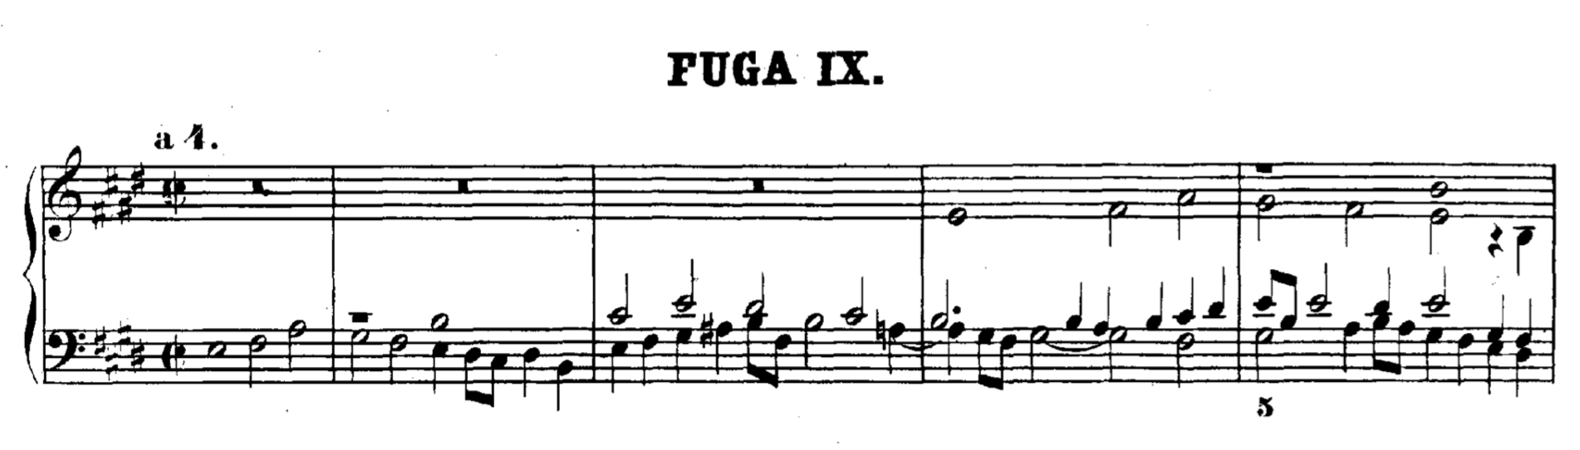
Bach, Fugue in E Major from Book II
of the Well-Tempered Clavier

Slide 5
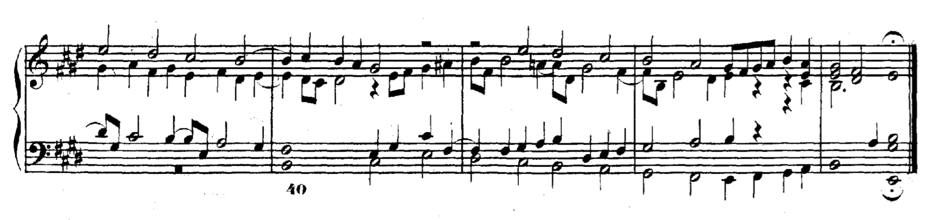
Bach, Fugue in E Major from Book II
of the Well-Tempered Clavier

Slide 6
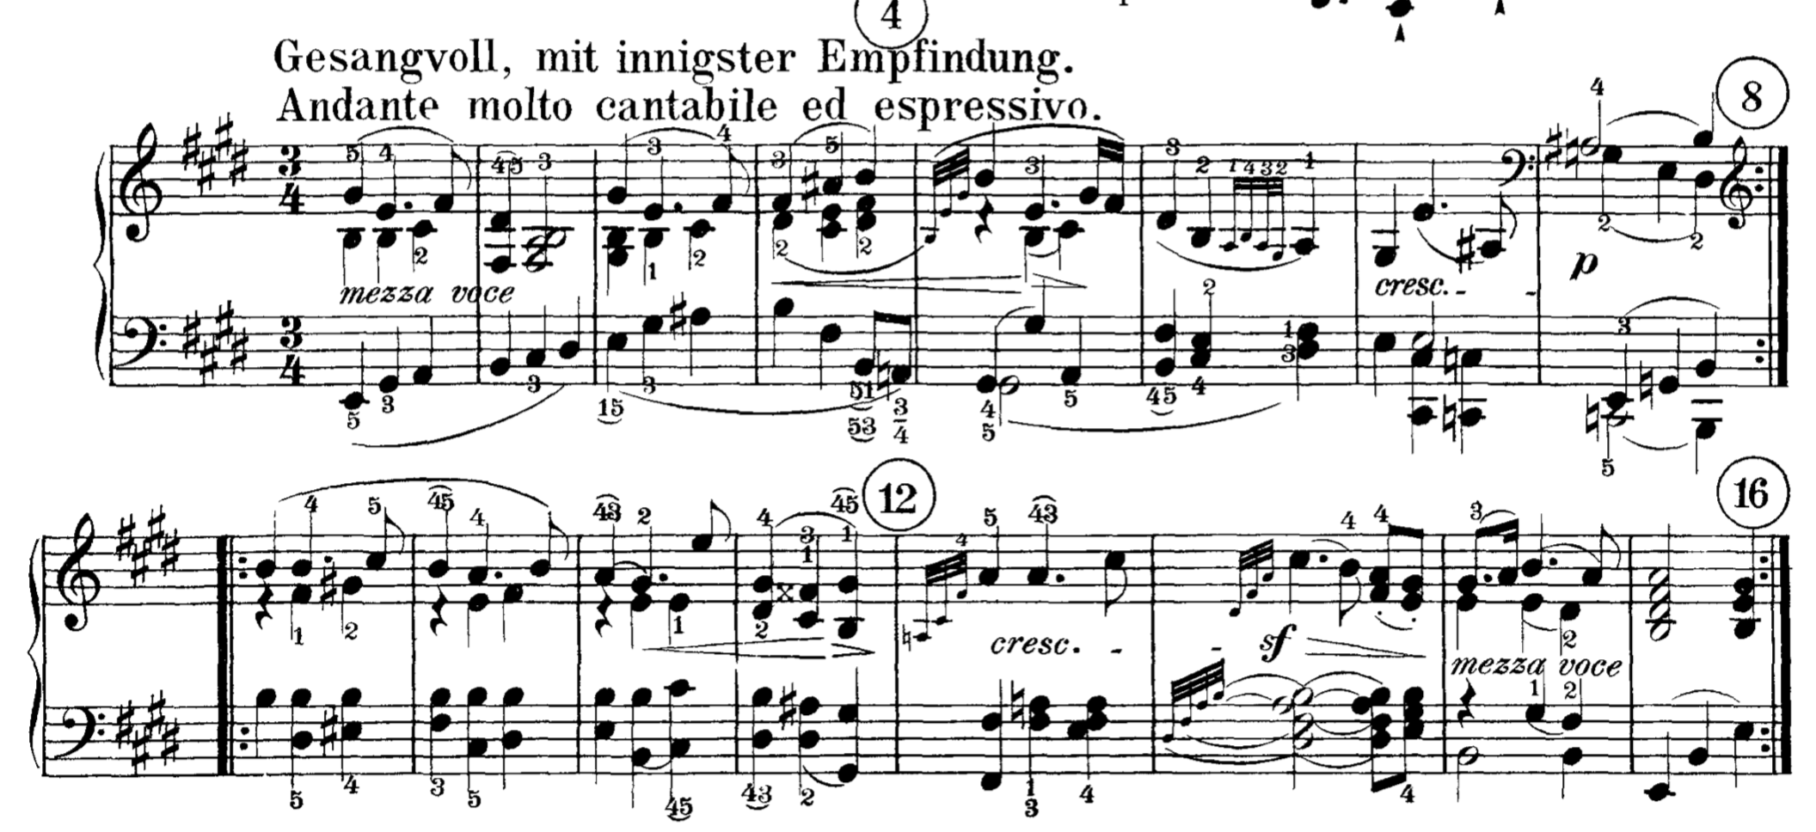
Beethoven, Piano Sonata in E Major, Op. 109
Third Movement, Theme

Slide 7
Beethoven, Piano Sonata in E Major, Op. 109
Third Movement, Theme

Slide 8
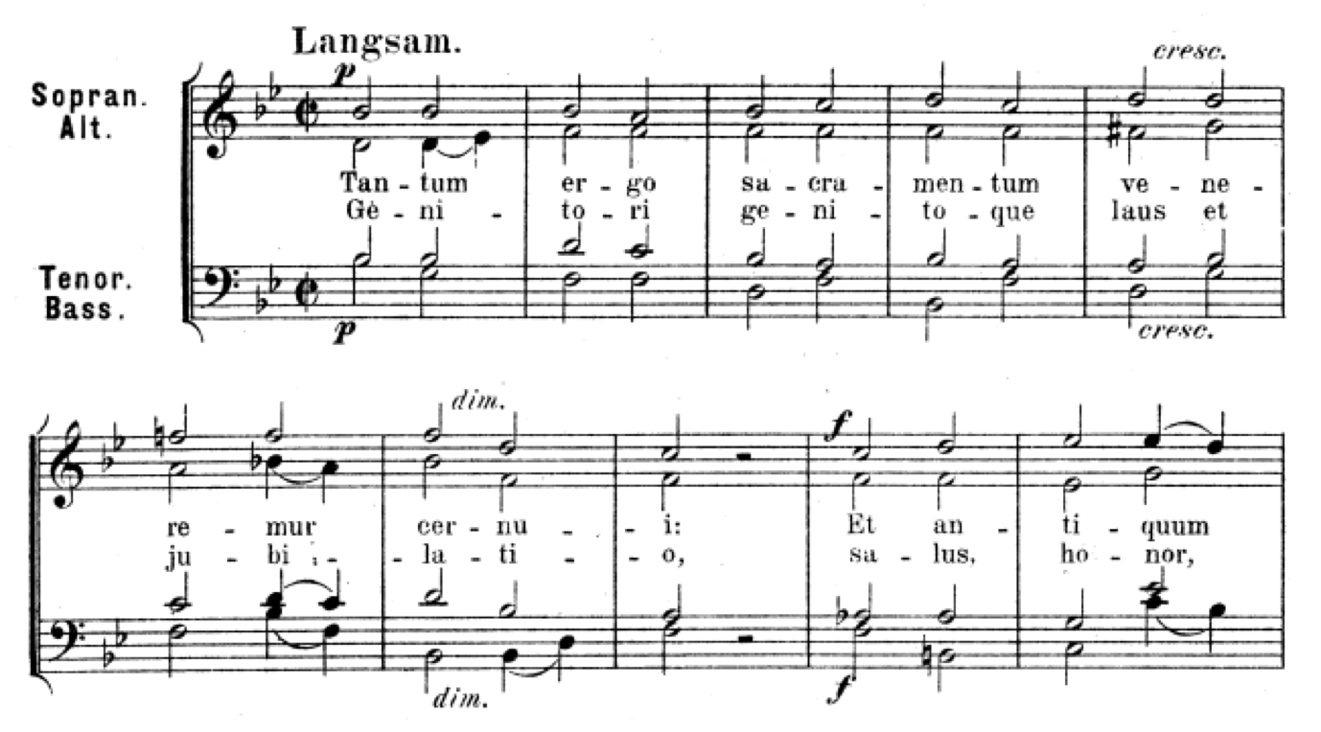
Sing: Bruckner, Tantum Ergo

Slide 9
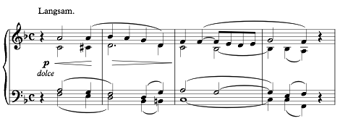
Sing: Schumann, “Beim Abschied zu singen”
Sing, Then Analyze

Slide 10
Sing: Schumann, “Beim Abschied zu singen”

Slide 11
Sing: Schumann, “Beim Abschied zu singen”

Slide 12
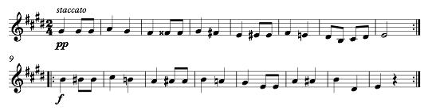
II. An Ecossaise Exercise:
Schubert, D. 299 No. 3
I. Sing Melody Alone
II. Sing With Accompaniment
III. Aural ID of Chords with raised chromaticism

Slide 13
Listening: Saturation with Applied Chords
* * * * * *
* * * * *

Slide 14
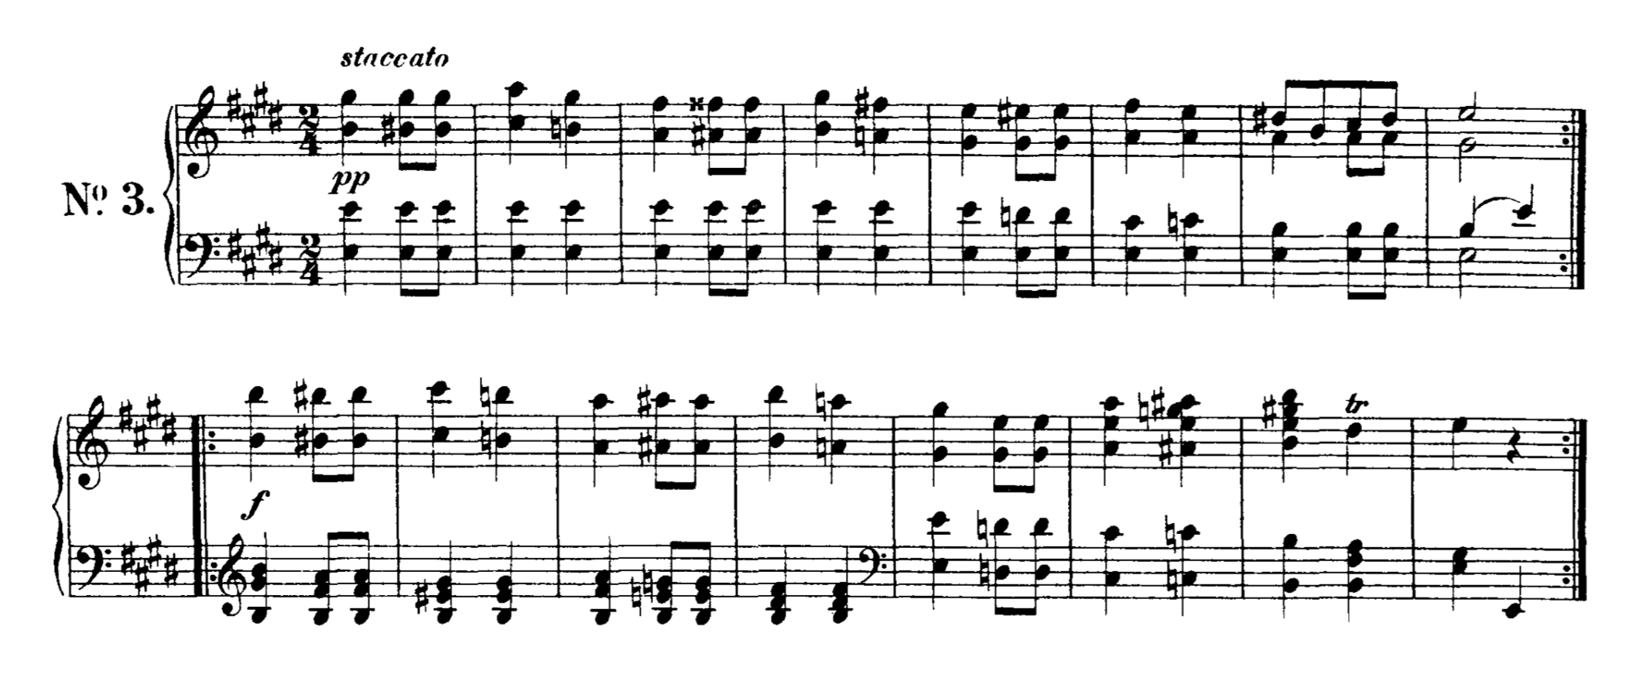
Schubert’s Solution

Slide 15
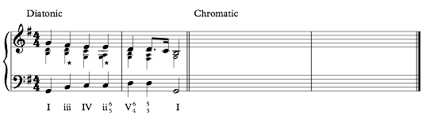
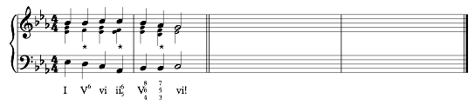
III. Harmonic Dictation
Solution on the board

Slide 16
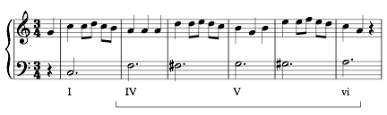
IV. A Chromatically Rising Bass?
A Christmas Minuet
? ?

Slide 17
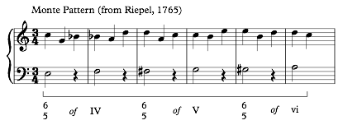
A “Monte” Pattern

Slide 18
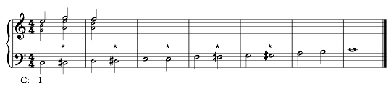
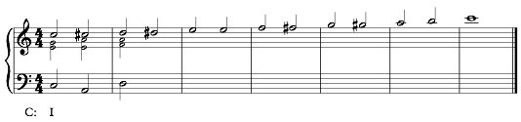
Apotheosis: Harmonizing a Chromatic Line
Sing These Ascending Lines
Complete the harmonization for Homework
(See also ) Mozart template on handout—

